Slide 1
R-LADIES GLOBAL COMMUNITY & VISION
library(dplyr)
rladies_global %>%
filter(city == 'ALL')

Slide 2
What is R-Ladies?
#rdogladies

Slide 3
Worldwide organization that promotes diversity in the #rstats community via meetups and mentorship in a friendly and safe environment

Slide 4

Our mission
more women coders
more women developers
more women speakers
more women leaders
more women developing and creating R Packages and being involved in the R community

Slide 5
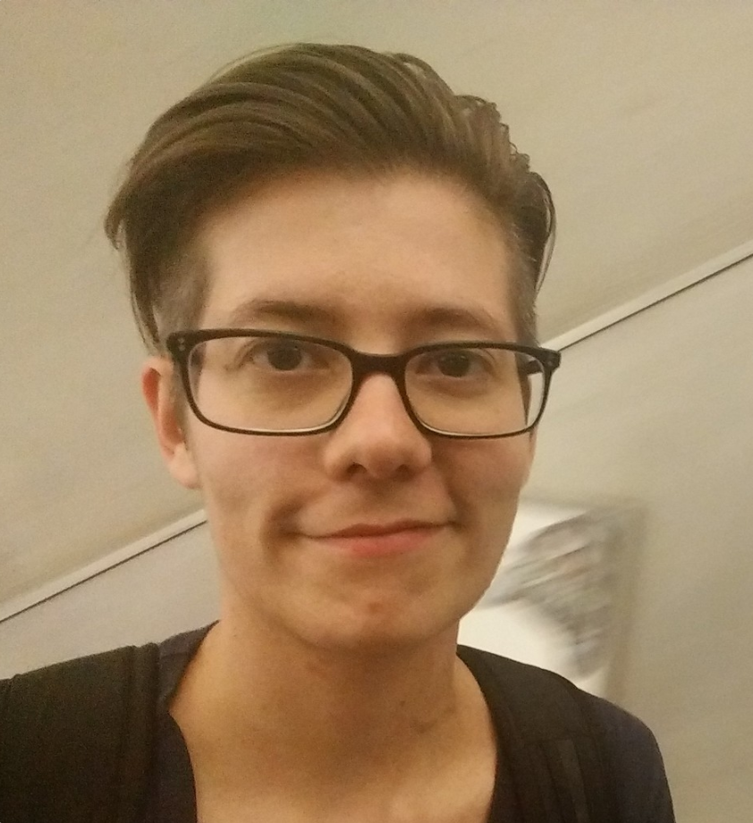
Who we are
The Leadership Team
Alice Daish
Claudia vitolo
Hannah frick
erin ledeLL
Gabriela de Queiroz
London
San Francisco

Slide 6
When R-Ladies was born?
#rchickenladies

Slide 7
San Francisco, CA
October 2012

Slide 8
June 2016 - useR!
San Francisco and London meet and get together to create …

Slide 9
#rdogladies
The R-Ladies Global!

Slide 10
What happened since, then?

Slide 11
R-Ladies Growth
20+ COUNTRIES
6000+ MEMBERS
45+ CITIES

Slide 12
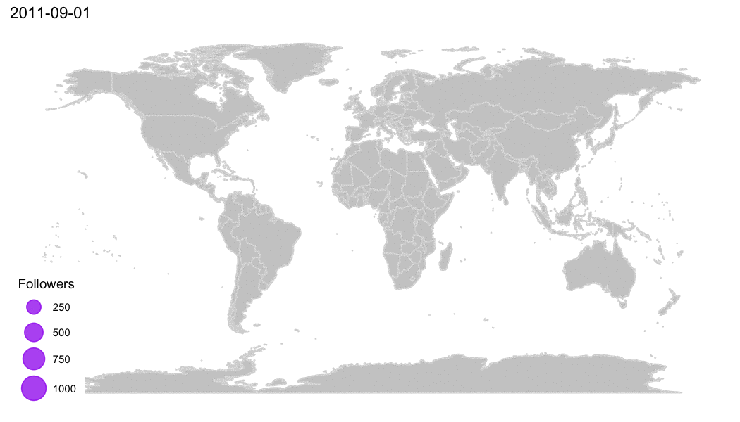
Twitter followers by each chapter
Made with 💜 by Daniela Vázquez

Slide 13
25% of the last Runconf (May 2017) attendees were R-Ladies!

Slide 14
How can I start my own chapter?
#rcatladies

Slide 15

Send an email to
info@rladies.org

Slide 16
We’ll send everything you'll need!
#rdogladies

Slide 17
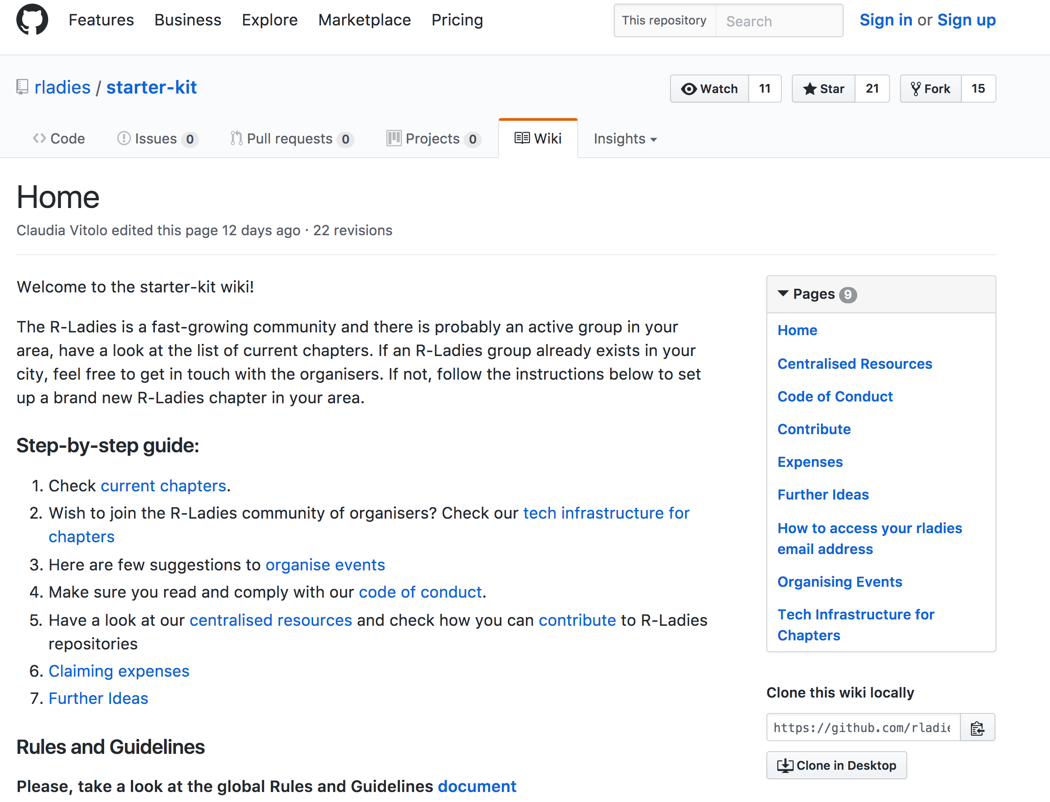
What do you get?
1) Starter-Kit
Tech Infrastructure
Tips on how to organize events
Code of Conduct (En/Spanish)
2) @rladies.org email
3) Organizer slack channel
4) Shared training material
5) Financial support to cover meetup registration/renewal fees!

Slide 18
And there is more!
YOU WILL:
- be part of an incredible family
- learn a lot (not onlyR)!
have unlimited support
meet other R-Ladies
+ MUCH MORE!

Slide 19
COME JOIN US!

Slide 20
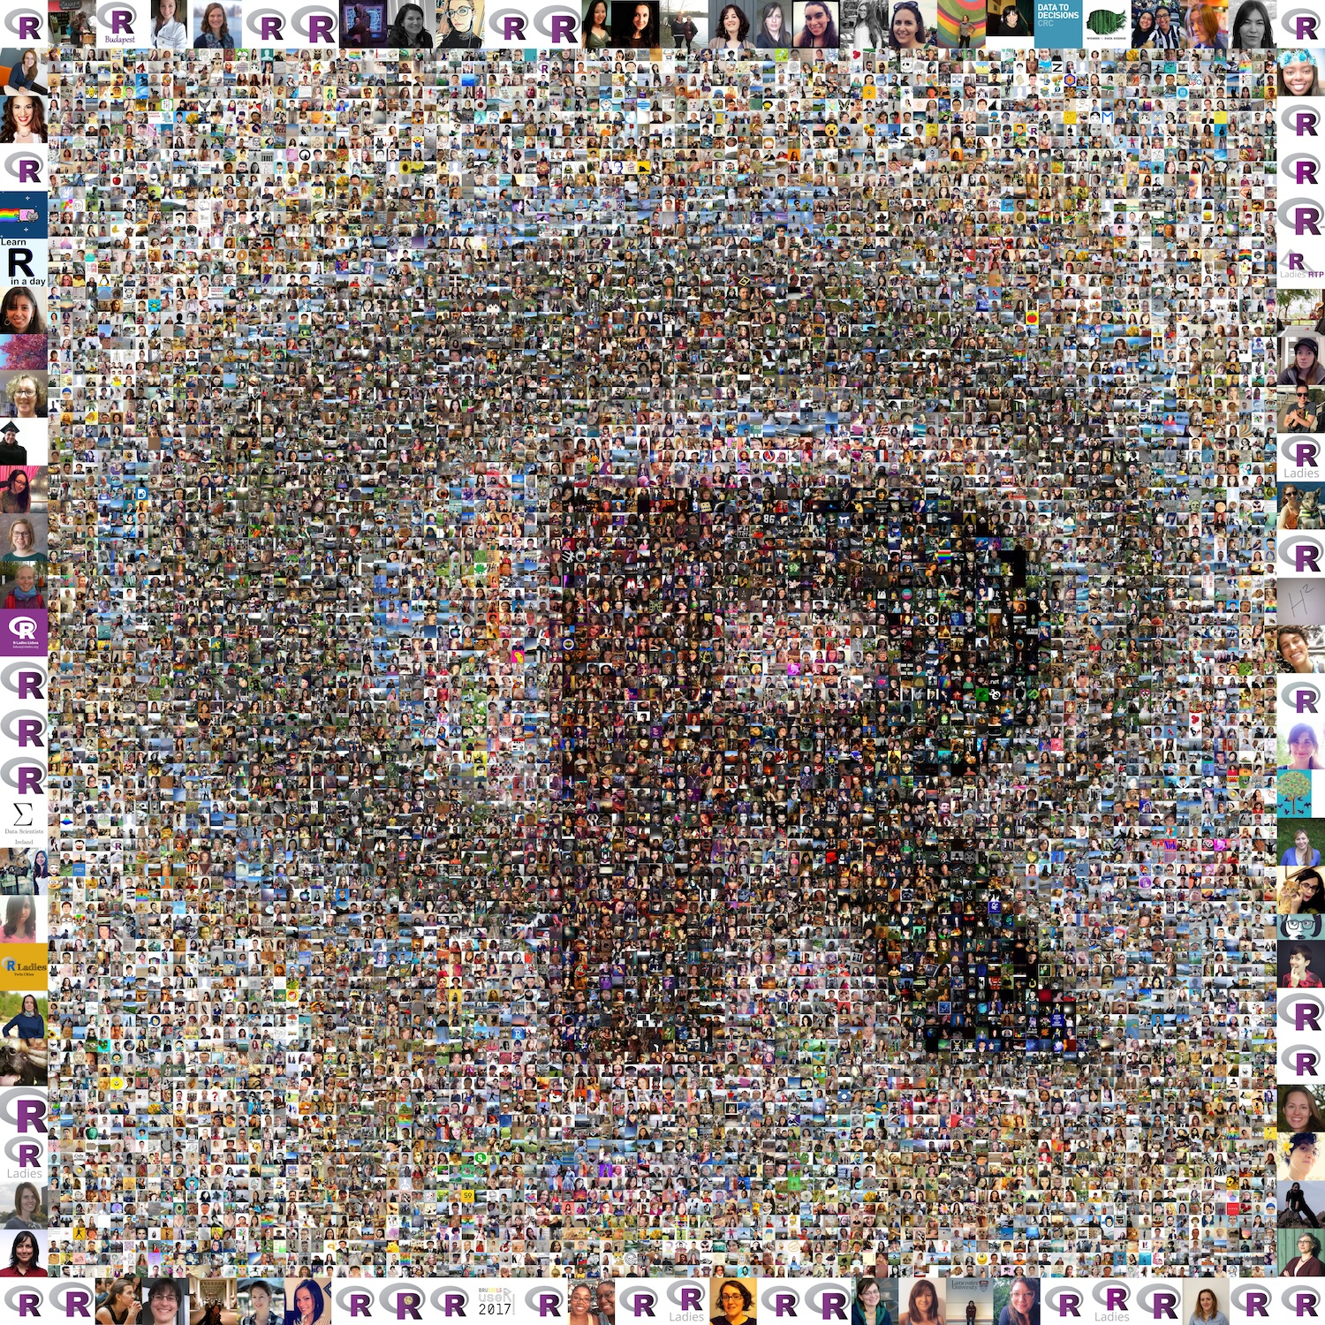
THANK YOU!
Website: rladies.org
Twitter: @RLadiesGlobal
Email: info@rladies.org

